Slide 1
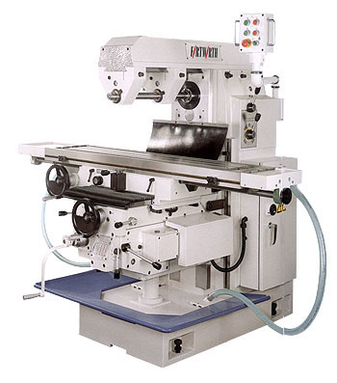
MILLING MACHINES

Slide 2
Milling Machine
Milling is a metal cutting operation in which the operating tool is a slow revolving cutter having cutting teeth formed on its periphery.
The milling cutter is a multipoint cutting tool. The work piece is mounted on a movable work table which will be fed against the revolving milling cutter to perform the cutting operation.

Slide 3
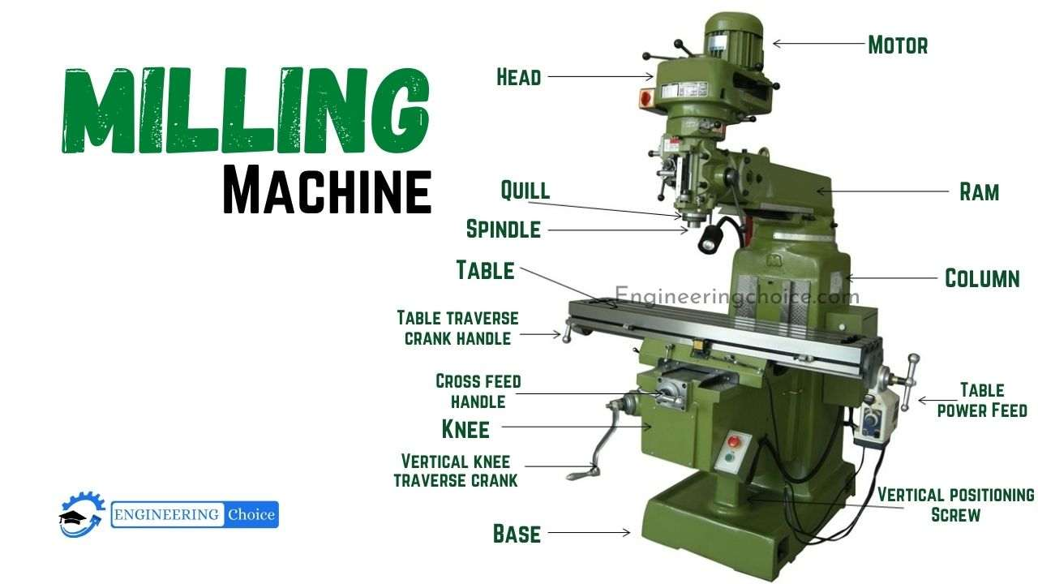

Slide 4
The difference between drilling and milling is that, in drilling a rotating drill is fed against a stationary work-piece, while in milling the work-piece is fed against a milling cutter which only revolves.
Similarly, it also differs from the lathe operation because the lathe tool is fed against rotating work-piece.
A milling machine is a power operated machine tool in which the work-piece mounted on moving table is machined to various shapes when moved under a slow revolving serrated cutter.

Slide 5
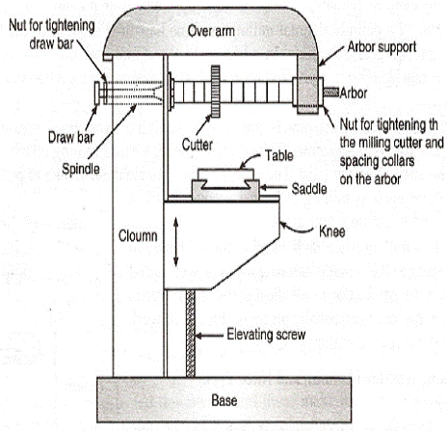

Slide 6
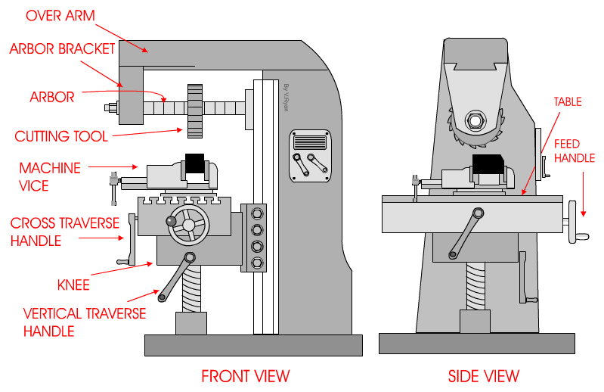

Slide 7
Principle of Milling
The Figure 1 shows the principle of cutting action of the milling cutter. The milling cutter is mounted on a rotating shaft known as arbor. The work-piece which is mounted on the table can be fed either in the direction opposite to that of the rotating cutter as shown in Fig.1A or in the same direction of that of the cutter as shown in Fig.1B.

Slide 8
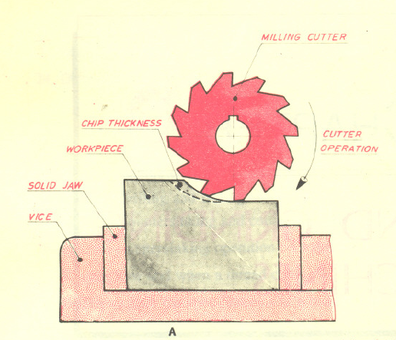
When the work-piece is fed in the opposite direction to the cutter tooth at the point of contact, the process is called conventional or up milling.
In this process, as the work-piece advances against the rotating cutter, the chip that is removed gets progressively thicker as shown in Fig.1A

Slide 9
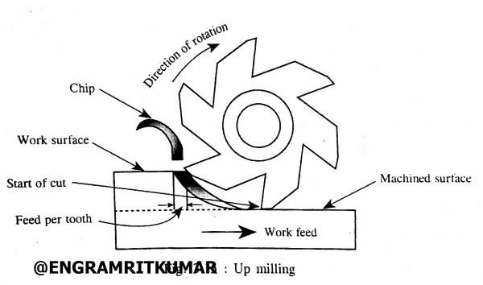
Up Milling or Conventional Milling

Slide 10
The action of the cutter forces the work-piece and the table against the direction of the table feed, thus each cutter tooth enters a clean metal gradually thus the shock load on each tooth is minimized.
The disadvantage of this method is that when making deep cuts, such as in heavy slotting operations, the cutter tends to pull the work-piece out of the vice or the fixture since the cutting force is directed upward at an angle.

Slide 11
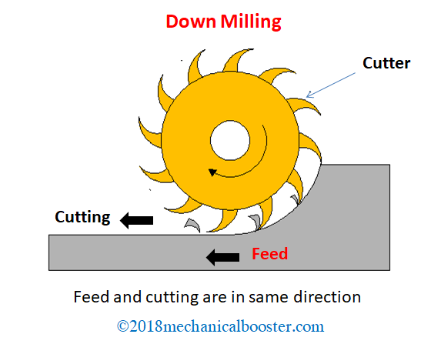
CLIMB MILLING or DOWN MILLING

Slide 12
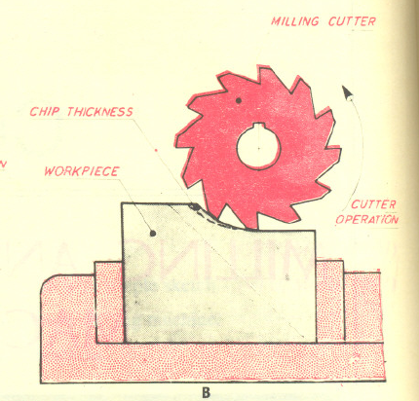
When the work-piece is fed in the same direction as that of the cutter tooth at the point of contact, as shown in Fig. 1B, the process is called climb or down milling.
In this process, the cutter enters the top of the work-piece and removes the chip that gets progressively thinner as the cutter tooth rotates.

Slide 13
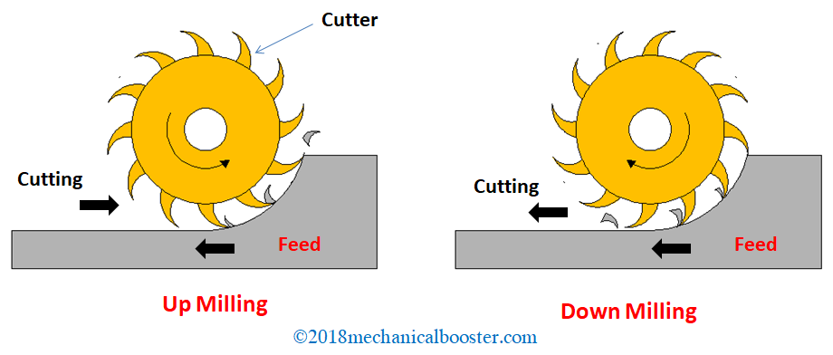

Slide 14
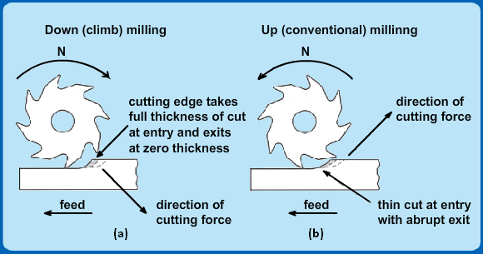

Slide 15
Generally, more metal can be removed for each cut than the conventional up milling. Climb milling is used only on materials that are free of scale and other surface imperfections that would damage the cutters.
Classification of Milling Machine
Plain or Horizontal Type of Milling Machine
Vertical Milling Machine
Universal Milling Machine
Planer Type Milling Machine
Profile Cutting Milling Machine

Slide 16
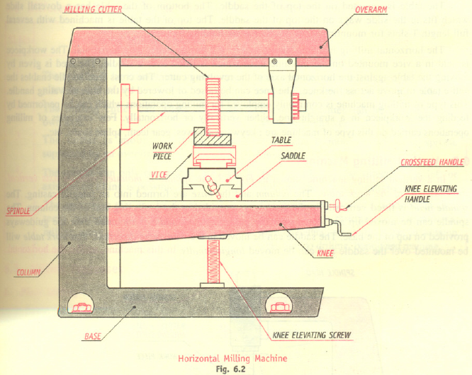

Slide 18
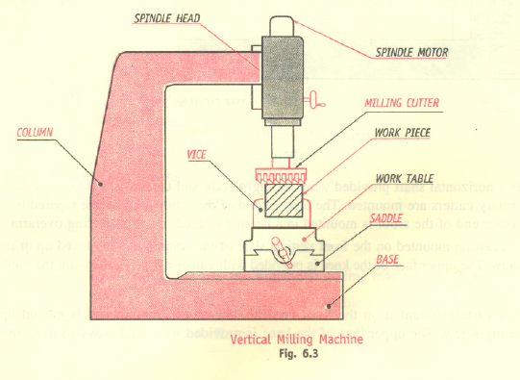

Slide 19
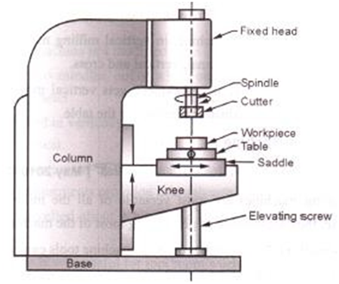

Slide 20
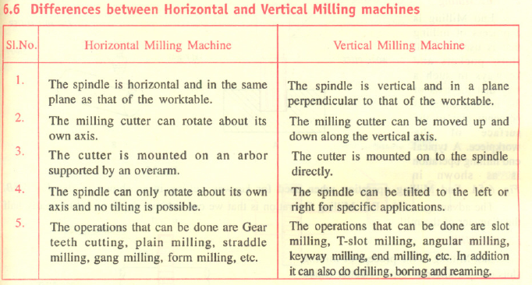

Slide 21
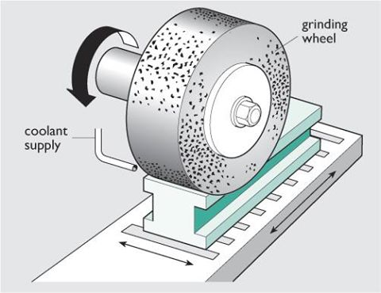
Grinding Machines

Slide 22
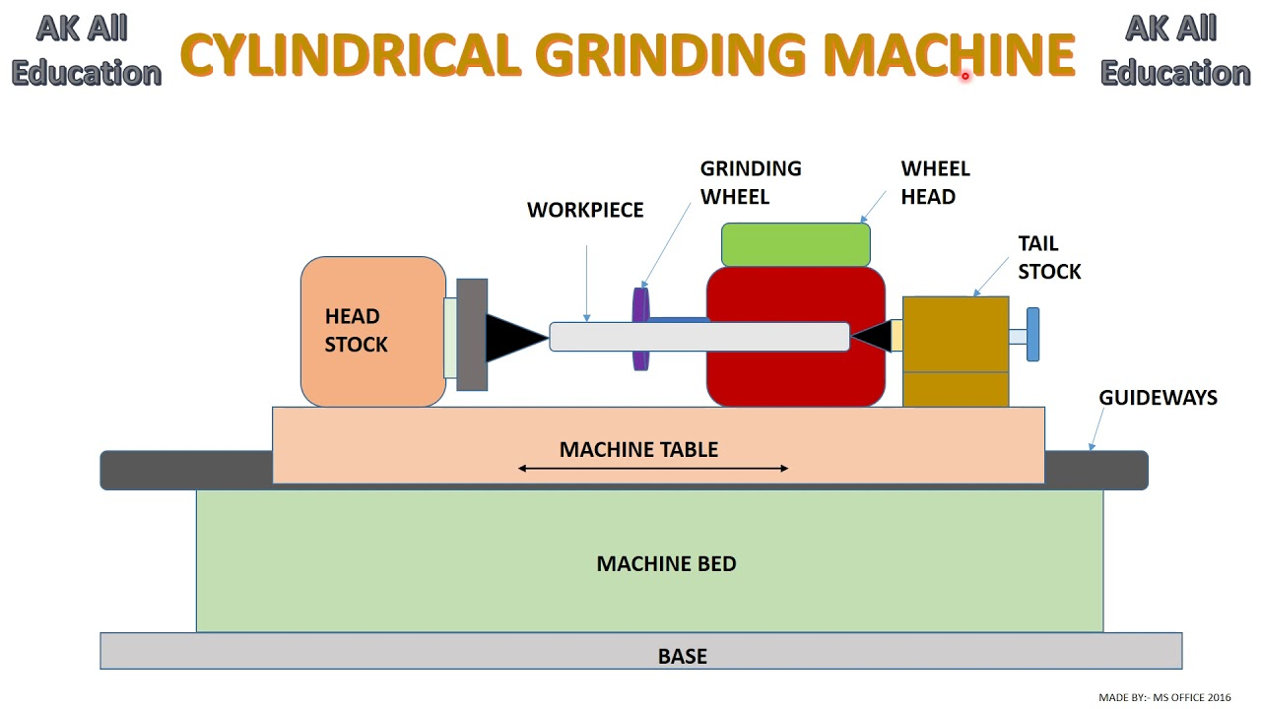

Slide 23
Grinding, also called abrasive machining, is a process in which the material is removed in the form of fine chips, almost as dust particles by the abrasive action using some kind of abrasive materials.
The thickness of the material chips removed by grinding ranges from 0.25 to 0.50 mm in finishing and general grinding operations.
Abrasive is the mineral material employed for sharpening, grinding and polishing operations

Slide 24
The two types of abrasives used are; natural and artificial.
The examples of natural abrasives are emery, corundum, quartz. sandstone, diamond, etc.
The important properties of abrasives are, hardness, toughness, uniformity in grain sizes, and sharpness.

Slide 25
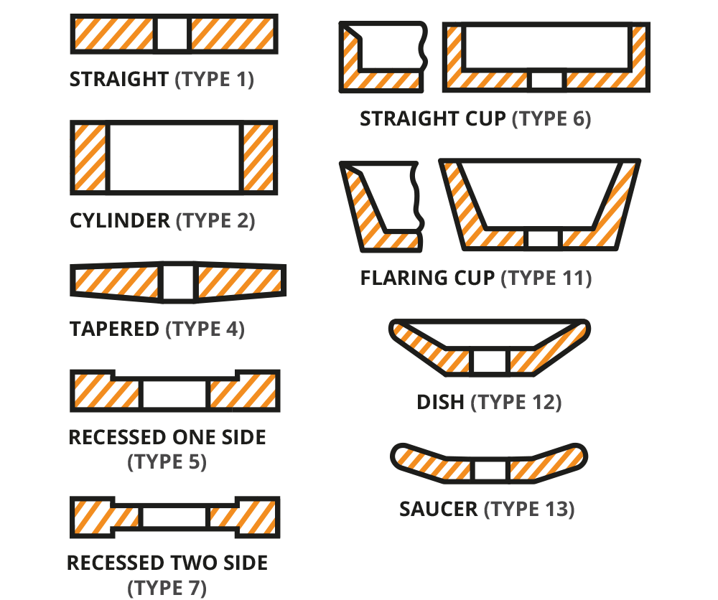
Types of Grinding Wheels

Slide 26
Grinding wheel Terminology

Slide 27
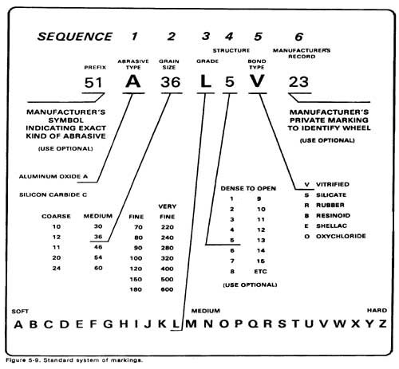

Slide 28
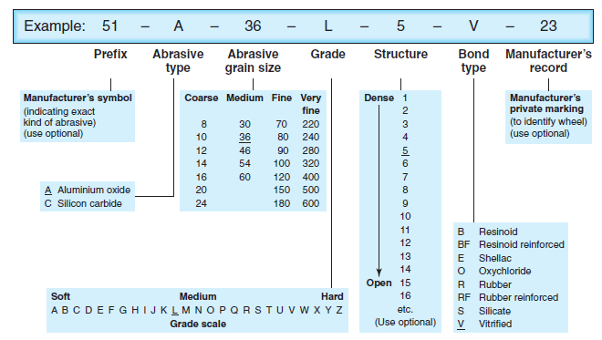
Grinding Wheel Designation

Slide 29
Grinding wheel Terminology
Grit
The grit is the grain size of the abrasive grain. The grain size can be classified as per the mesh number of the screen through which the grain falls. The grain size is expressed as a number. Thus, coarse grain size can be between 10 and 24, Medium grain size can be between 30 & 60, Fine grain size can be between so and, very fine grain size can be between 220 and 600.

Slide 30
Grade
Grade is the hardness of the bond, which is designated by alphabets. The letter "A" Stands for very soft material and the letter " Z" stands for very hard grade.
Wheel structure
The abrasive grains are distributed over the abrasive wheel in a structural form. The wheel structure is also represented as a number. For example, Dense can be from 1 to 8 and Open can be from 9 to I5.

Slide 31
Bond type
It is denoted by alphabets like V is for vitrified Bond, B is for Resinoid, R is for Rubber, E is for shellac and S is for silicate, and so on.
Abrasive
Abrasives are denoted by alphabets-Example: A stands for Aluminum oxide & C Stands for Silicon Carbide.

Slide 32
Types of Grinding Machines
Cylindrical Grinding Machine.
Surface Grinding Machine.
Horizontal Spindle and Rotating Table
Vertical Spindle and Rotating Table
Horizontal Spindle and Reciprocating Table
Vertical Spindle and Reciprocating Table
Centre-less Grinding Machine.

Slide 33
Surface Grinding Machine

Slide 34
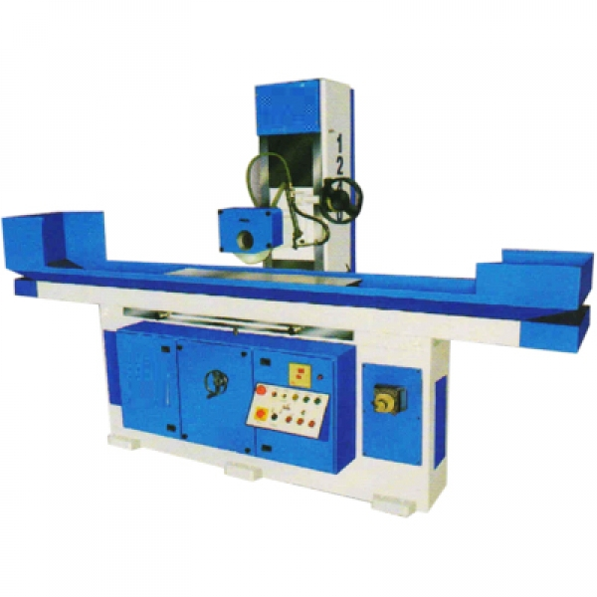

Slide 36
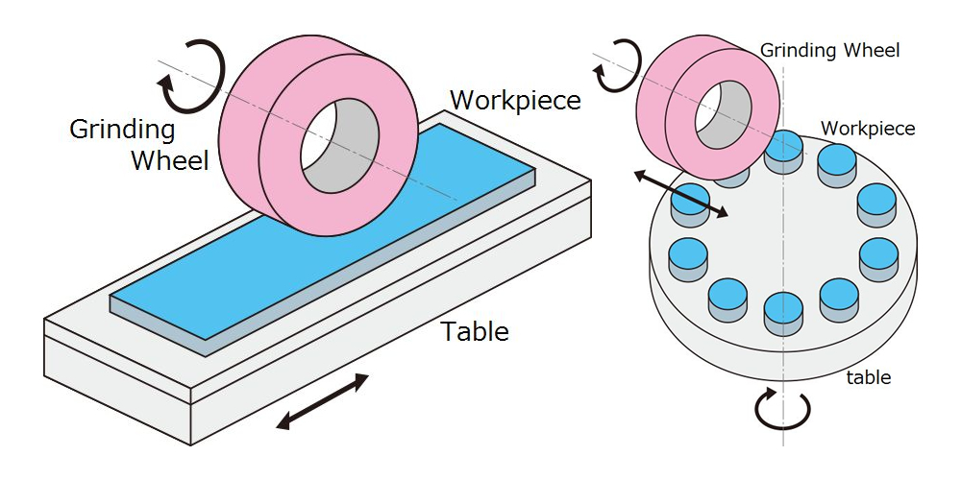

Slide 37
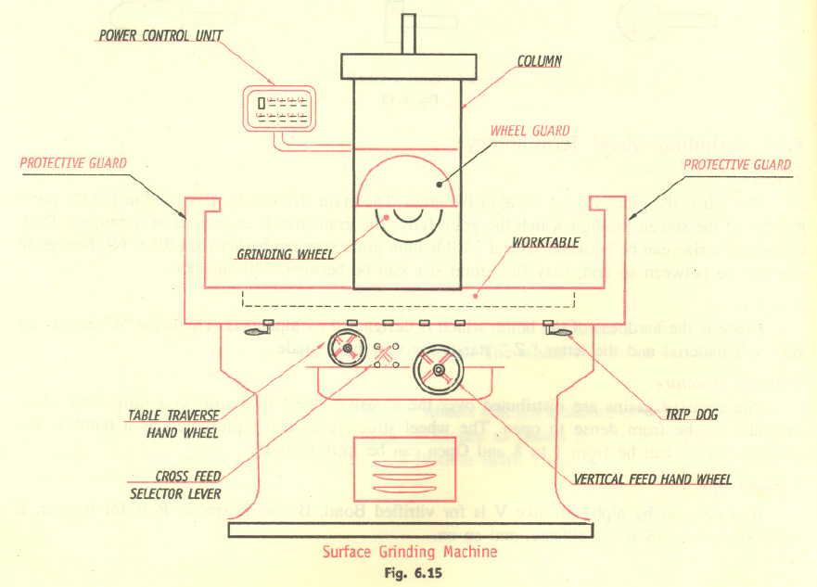

Slide 38
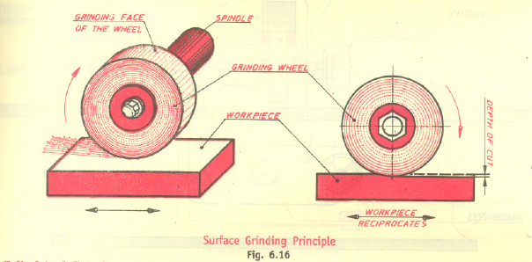

Slide 39
Cylindrical Grinding Machine

Slide 40
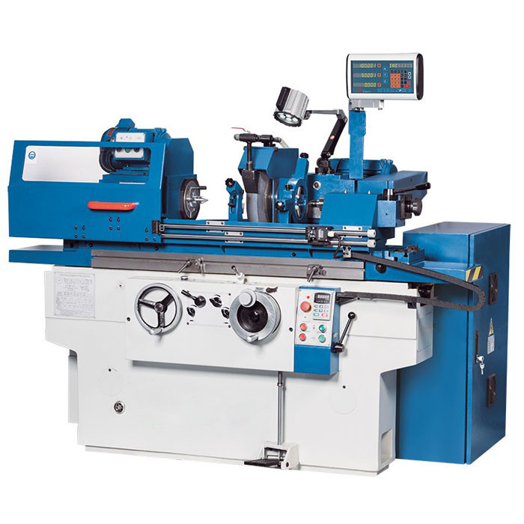

Slide 41
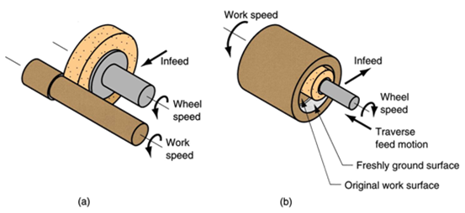

Slide 42
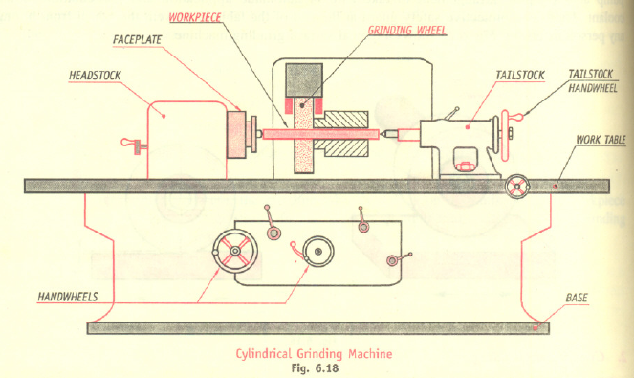

Slide 43
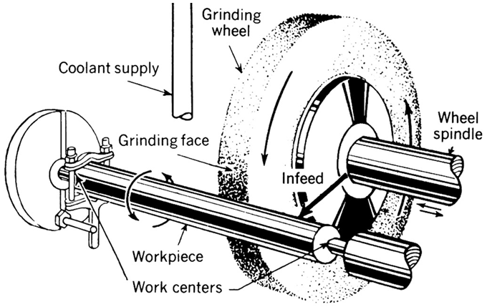

Slide 44
